Slide 1

Data Base Management System
Project
Hospital management system
Group No : 12
Group Members :
Janvi Patel 201501072
Nishi Patel 201501076

Slide 2
Description:
Many hospitals use a manual system for the management and maintenance of critical information.
The current system requires numerous paper forms, with data stores spread throughout the hospital management infrastructure. Often information is incomplete, or does not follow management standards.
Forms are often lost in transit between departments requiring a comprehensive auditing process to ensure that no vital information is lost. Multiple copies of the same information exist in the hospital and may lead to inconsistencies in data in various data stores.
The project aims to manage the hospital easily and keep the record of patients and to improve overall operational excellence at healthcare facilities by enhancing the patient experience.
Our system helps to manage a seamless flow of patients right from an initial entry point to check out.

Slide 3
Features:
Hospital management system is an multibuilding hospital.
The system contains :
staff information
User information
Registration
Appointment details
Patient’s personal information
Patient’s health information
medicine details of patient
Room which were allocated for the patients and details of the room
patient check out details
Total bill of every patients containing medicine fee, doctor fees, service fees, Room price and also the type of billing (check, cash or policy through payment).
The system is basically for the staff member’s usage. They can login in the system by their own id and password.

Slide 4
Assumptions:
In our project, we are considering database for managing the hospital. We are considering Doctor, Nurse, Manager, Pharmacist, Cashier, Receptionist can login in to System by their unique I’d and password.
Receptionist gives appointment and register the patient in hospital.
Manager manages new ward information, blood donation part, patient policy details.
Doctor treats the patients, there are 3 kind of doctor- trainee, visiting, permeant. Nurse takes care of patients and keep room information.
Cashier keeps track of patient’s bill.
Pharmacist handles the medicine details of patients.
For staff member’s salary, we assume salary per month.
We are considering 3 types of doctor: trainee, visiting, permanent.

Slide 5
Continued…
For staff Id ,we are considering data type varchar (9) in such a way that first 4 letters are for year in which the staff member had joined the hospital than 2 letters for their position and the last 3 letters for the Id number.
For first 4 letters of year we are considering the year in which person joins the hospital.
Here, the position in 2 letter means Doctor as Dr, Nurse as Nu, Manager as Mr, Pharmacist as Ph, Cashier as Ca, Receptionist as Re, Sweeper Sw, Watchman Wa.
We are considering that once the patient registered in the hospital the unique Id will be given to the patient than if after some time patient again visit to the hospital then the Id will be same so that we can know the past history of that patient.
Here, we are considering the room no and block combine as a primary key like block can be A or B or C than the primary key will be A-304 so that we can easily found that which room is located to which patient.

Slide 6
Entities:
Appointment 14. Patient Check out
Registration 15. Patient total bill
Login 16. Payment Check
User information 17. Patient Policy
Staff information 18. Blood donation
Staff address
Patient information
Patient address
Patient Health information
Patient Medical information
Room
Room facility
New ward

Slide 7
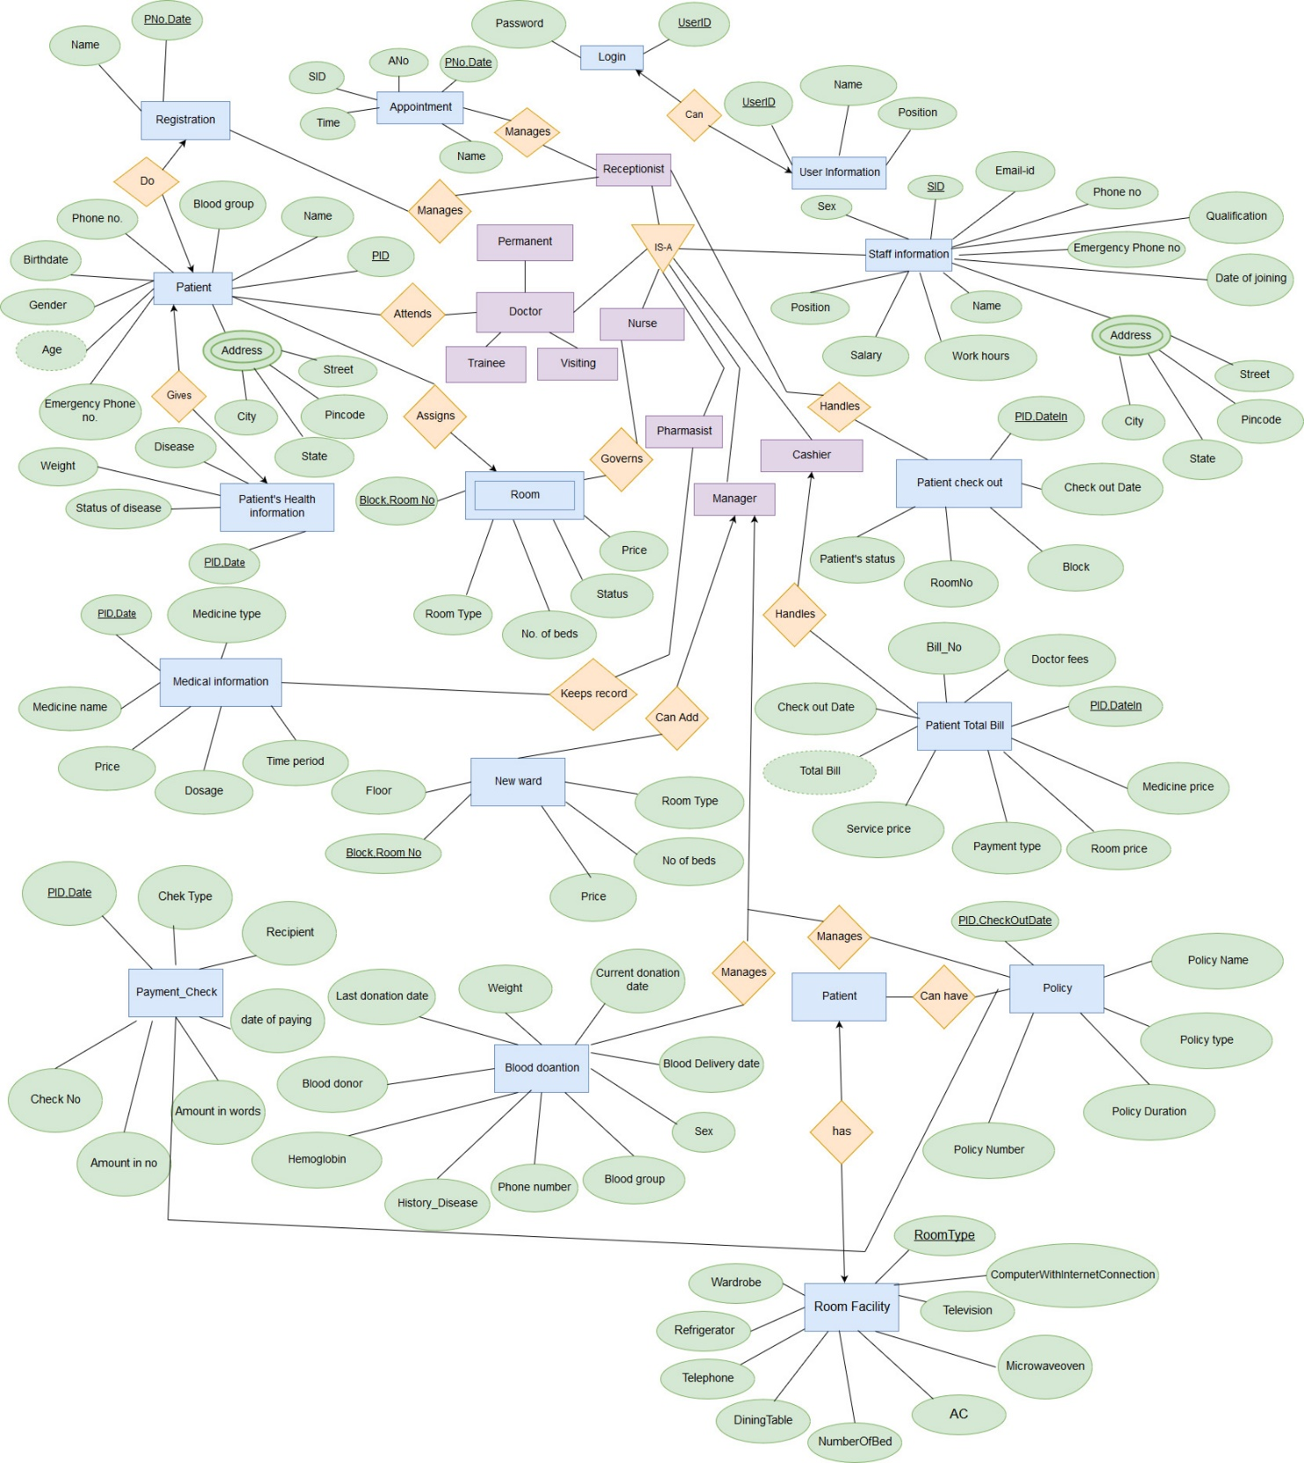
ER diagram

Slide 8
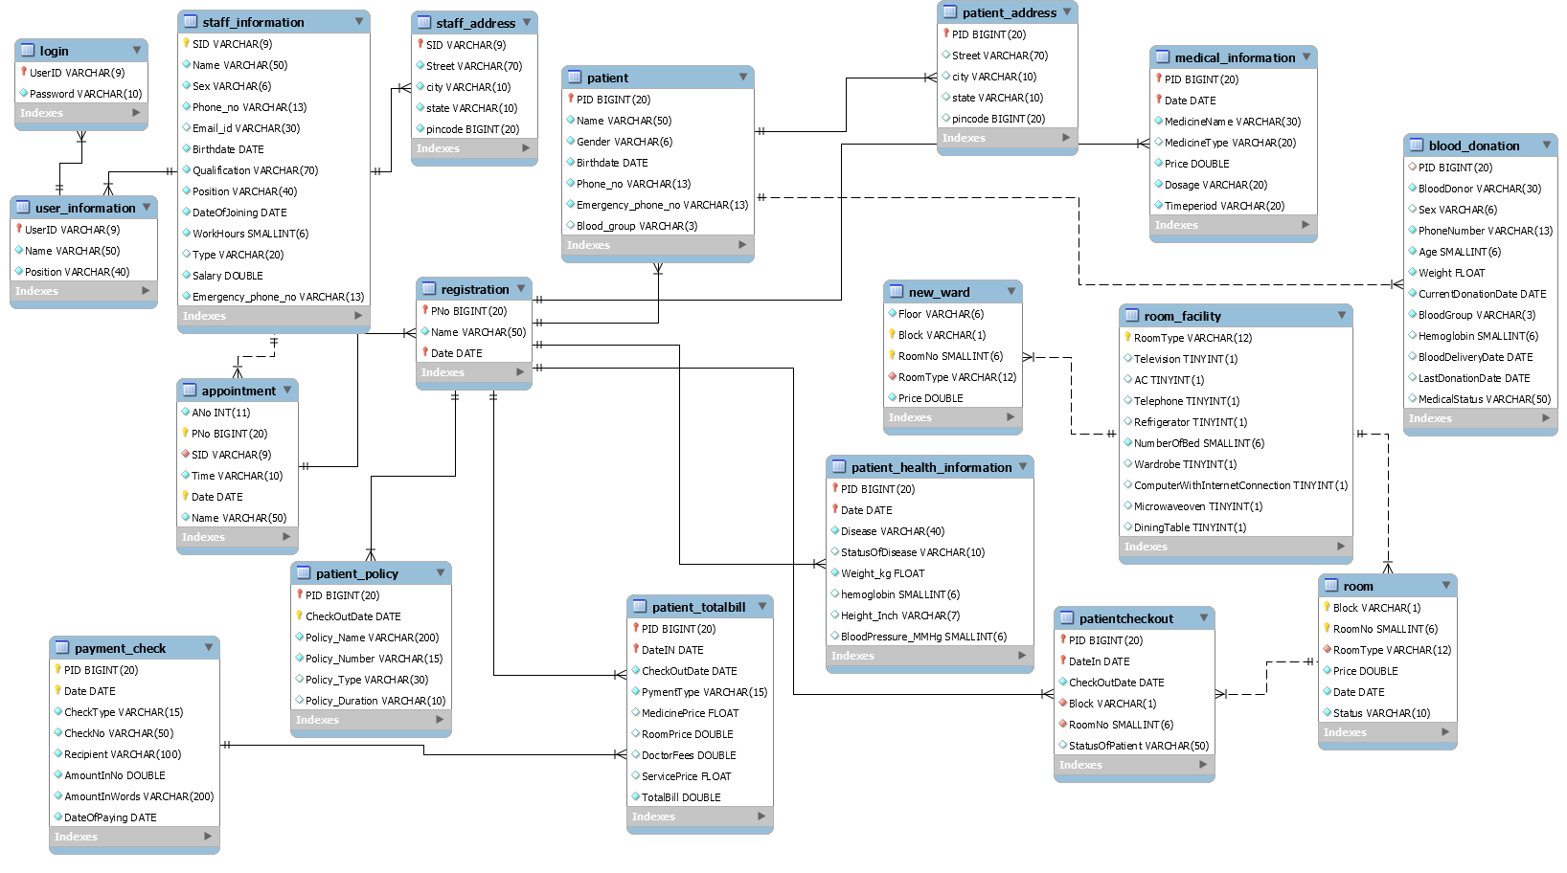
Relational Schema Diagram:

Slide 9
Normalization
1st NF
There should scalar values only. Multiple values not allowed.
Example: Any staff member can has more than one phone no. So we made 2 different filed for phone number. One is phone number and another is emergency phone number.
Address field is multivalued attribute so we made different field like, street, city, state, pin code for making it to scalar.
Attributes | Data type | Constraints
SID | Varchar(9) | Primary Key
Street | Varchar(70) | Not null
City | Varchar(10) | Not null
State | Varchar(10) | Not null
Pin code | Big integer

Slide 10
Continued…
2nd NF
The database is in first normal form
All non-key attributes in the table must be functionally dependent on the entire primary key.
Example:
1. Table Patient
Key : {PID}
Scheme : {PID, Name, Gender, Birthdate, Phone_no, Emergency_phone_no, Blood_group}
Functional dependency : {Name, Gender, Birthdate, Phone_no, Emergency_phone_no,Blood_group} {PID}
2. Table login
Key : {User_ID}
Scheme : {Password}
Functional dependency : {Password} {User_ID}

Slide 11
Continued…
3rd NF :
The table should be in first and second normal form.
No attribute is transitively dependent on the primary key.
Wherever there is address field, we include attributes like city, street, pin code, state. So, we make different table of address and PID/SID as primary key. Because from city we can get state, pin code etc.
Example :
Attributes | Data type | Constraints
PID | Big integer | Primary Key
Street | Varchar(70)
City | Varchar(10)
State | Varchar(10)
Pin code | Big integer

Slide 12
Continued…
BCNF :
The table should be in third normal form.
If primary key is derived from candidate key, then it is not in BCNF.
In our case there is no way to derive primary key from candidate key. So all tables in our database is in BCNF form.

Slide 13
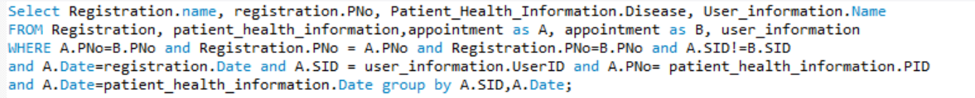
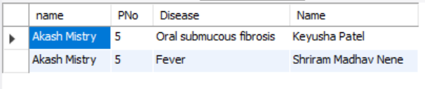
Queries:
1. Find the names, PID, disease, doctor’s name of the patients who have visited to more than one doctor.

Slide 14
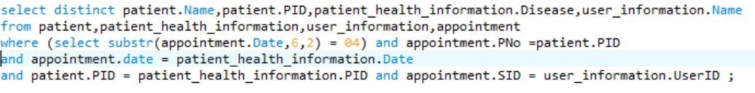
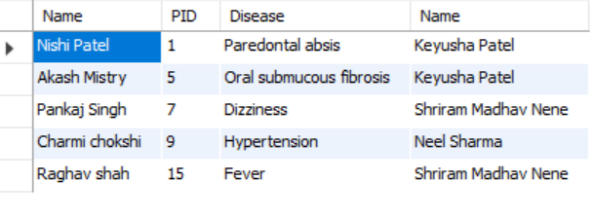
2. Obtain the information for appointments where a patient met with doctors other than his/her primary care physician.

Slide 15
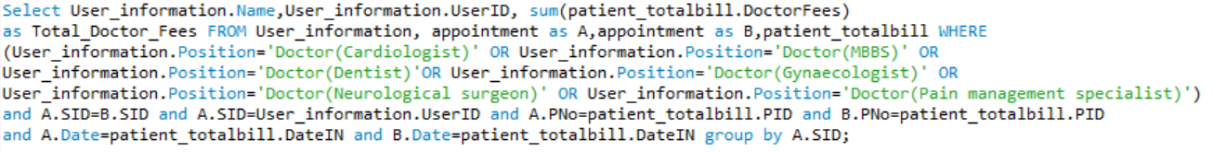
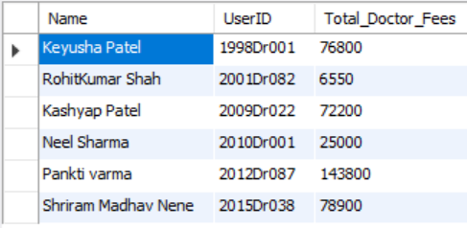
3. Display doctor id, doctor name, total fees received by the doctor(s) who have treated more than one patient.

Slide 16
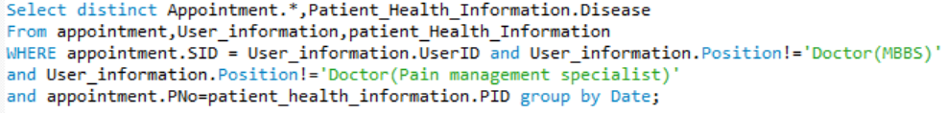
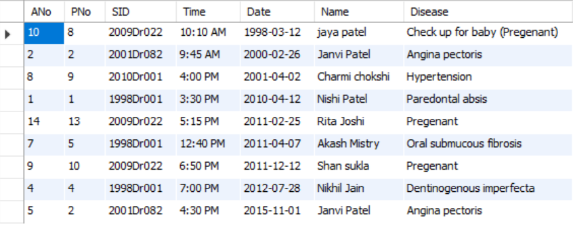
4. Obtain the information for appointments where a patient met with doctors other than his/her primary care physician.

Slide 17
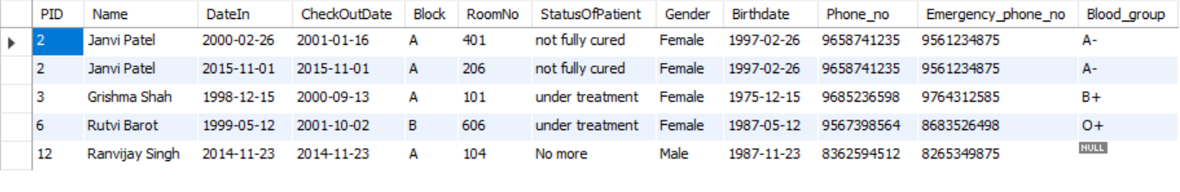

5. List of patients who are not cured while checkout.
6. List the detail of blood donor who can donate to any person.

Slide 18
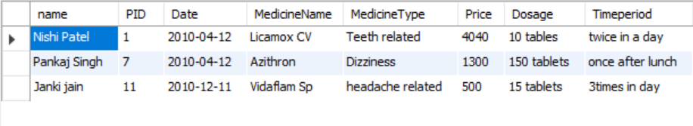
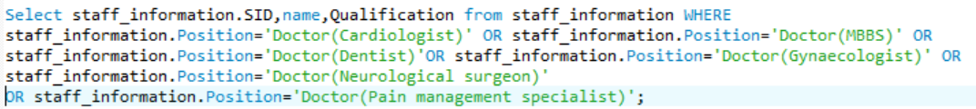
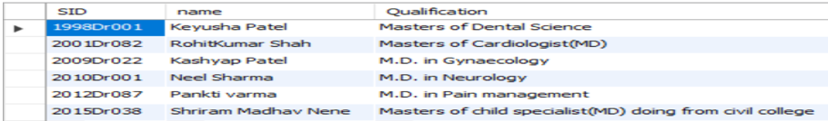
7. Give Name, Patient id and medicine information in year 2010.
8. List doctor Id, doctor name and qualification of doctor

Slide 19
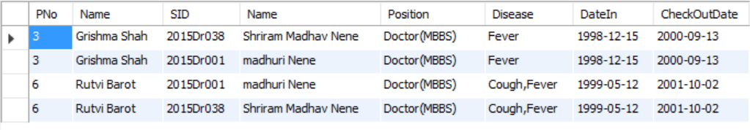
Stored Procedure:
Suggest another doctor name to the patient who is not cure for one disease by one doctor in more than 1 year.
DELIMITER $$
CREATE PROCEDURE suggest_doctor()
BEGIN
Select distinct appointment.PNo,appointment.Name,B.SID,B.Name,B.Position,
patient_health_information.Disease,patientcheckout.DateIn,CheckOutDate from
staff_information as A , staff_information as B,appointment,patientcheckout,
patient_health_information WHERE patientcheckout.StatusOfPatient='under treatment'
and (select patientcheckout.PID WHERE (substr(patientcheckout.CheckOutDate,1,4)- substr(patientcheckout.DateIn,1,4))>1)=appointment.PNo and appointment.SID=A.SID and A.Position = B.Position and appointment.PNo=patient_health_information.PID order by appointment.Name;
END $$
call suggest_doctor();

Slide 20


Continued…
User information whose position is Receptionist.
DELIMITER $$
CREATE PROCEDURE user_info()
BEGIN
SELECT UserID,Name FROM User_informationWHERE Position='Receptionist';
END $$
call user_info();
List particular room type and its rate.
DELIMITER $$
CREATE PROCEDURE room (IN var varchar(12))
BEGIN
SELECT distinct RoomType,Price FROM room WHERE RoomType=var;
END $$
call room('Executive');

Slide 21
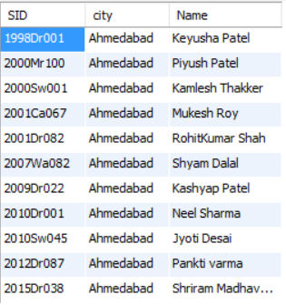
Continued…
Give the list of staff members who lives in ‘Ahmedabad’.
DELIMITER $$
CREATE PROCEDURE staff_addr()
BEGIN
SELECT staff_address.SID,city,staff_information.Name FROM staff_address,staff_informationWHERE
staff_address.city='Ahmedabad' and
staff_address.SID=staff_information.SID;
END $$
call staff_addr();

Slide 22
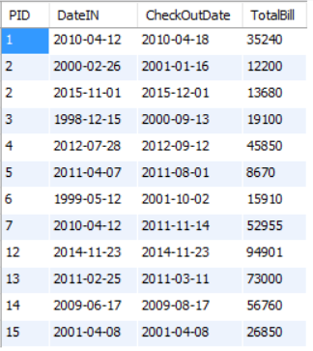
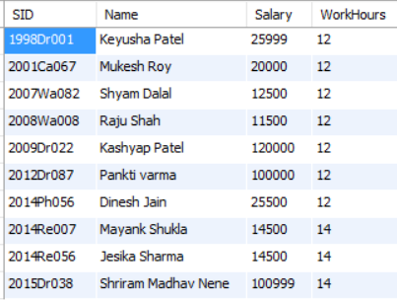
Continued…
The patient has undergone a procedure with a cost larger than 5,000.
DELIMITER $$
CREATE PROCEDURE bill ()
BEGIN
SELECT PID,DateIN,CheckOutDate,TotalBill FROM Patient_TotalBill
WHERE TotalBill>5000;
END $$
call bill ();
Provide details of staff members who works more than 10 hours.
DELIMITER $$
CREATE PROCEDURE staff_info()
BEGIN
SELECT SID,Name,Salary,WorkHours FROM staff_information
WHERE WorkHours>10;
END $$
call staff_info ();

Slide 23
TRIGGER:
When doctor retire (retirement age 65 years) remove their details from database.
DELIMITER $$
CREATE TRIGGER doctor_retirement
BEFORE UPDATE ON staff_information
FOR EACH ROW
BEGIN
DELETE FROM staff_information WHERE YEAR(curdate()) - YEAR(staff_information. Birthdate) > 65;
DELETE FROM staff_address WHERE staff_address.SID = staff_information.SID;
DELETE FROM user_information WHERE user_information.UserID = staff_information.SID;
DELETE FROM login WHERE login.UserID = staff_information.SID;
END; $$
DELIMITER $$

Slide 24
Automatically generate total bill.
DELIMITER $$
CREATE TRIGGER total_bill
BEFORE UPDATE ON Patient_TotalBill
FOR EACH ROW
BEGIN
SELECT sum(MedicinePrice, RoomPrice, DoctorFees, ServicePrice) as TotalBill FROM Patient_TotalBill;
END; $$
DELIMITER $$

Slide 25
THANK YOU!!

